Slide 1
Step 1:
Data preprocessing
Step 2:
Model Training
Step 3:
Interpretability
3.1 Variable
Importance
Perimeter_worst
Concave points_worst
H2O preparation
3.2 Partial
Dependence plots
Perimeter_worst
Concave points_worst
Train H2O Model
Data preparation
H2OGradient
Boosting
Estimator
3.4.2
Train
H2OGradientBoosting Estimator
3.4.3
Train
H2OGeneralizedLinear Estimator
3.4 Local Interpretable Model-agnostic explanations
(LIME)
3.4.1
Correlation Removal
LIME 1
LIME 2
Train General Model
3.3 Individual Conditional Expectation
Gradient
Boosting
Classifier
pycebox.ice
H2O Model

Slide 2
WHAT is Interpretability?
In the context of machine learning models and results, interpretability has been defined as: the ability to explain or to present in understandable terms to a human [7].
[7. Finale Doshi-Velez and Been Kim. Towards a rigorous science of interpretable machine learning. arXiV preprint, 2017 ]
Interpretability
Support/Optimize
decision-making process
(For human experts)
black-box models
comprehensible
Nonlinear
complex

Slide 3
WHY Interpretability?
Situation:
An overly complex model will be…
Make the model explanation harder.
Makes models harder to trust and understand.
Difficult to debug with the ‘black box’ model.
Make unstable predictions on new data.
…
Strengths:
The interpretability will help:
Increase the transparency and accountability of complex models.
Present in understandable terms to a human
Enable users to debug models for accuracy and fairness
Achieve highest predictive accuracy

Slide 4
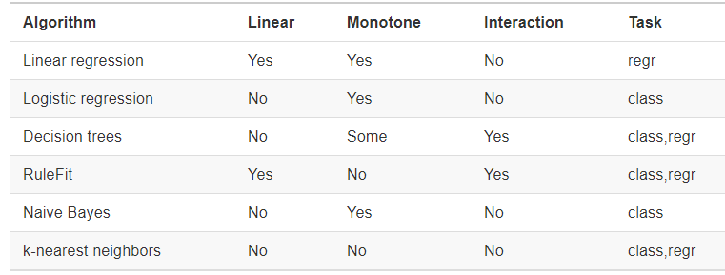
HOW Interpretability?
Simple functions:
can be used to explain more complex functions
Incorporates a number of contemporary approaches:
• Surrogate models
• Variable Importance
• Partial dependence plots (PDP)
• Individual conditional expectation (ICE) plots
• Local interpretable model-agnostic explanations (LIME)
• Shapley Values ….
3. Use only a subset of algorithms that create interpretable models.

Slide 5

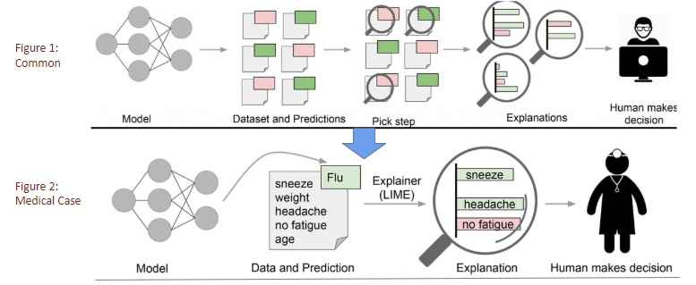
???
Before
Black box
Interpretability
!!!
After

Slide 6
predict
explain
Cancer risk
Prediction
Explanations
support vector machine
surrogate method
Decision Trees
Local surrogate models
Global surrogate models

Slide 7





Features & Dataset
Variable
Importance
Model

